Slide 1
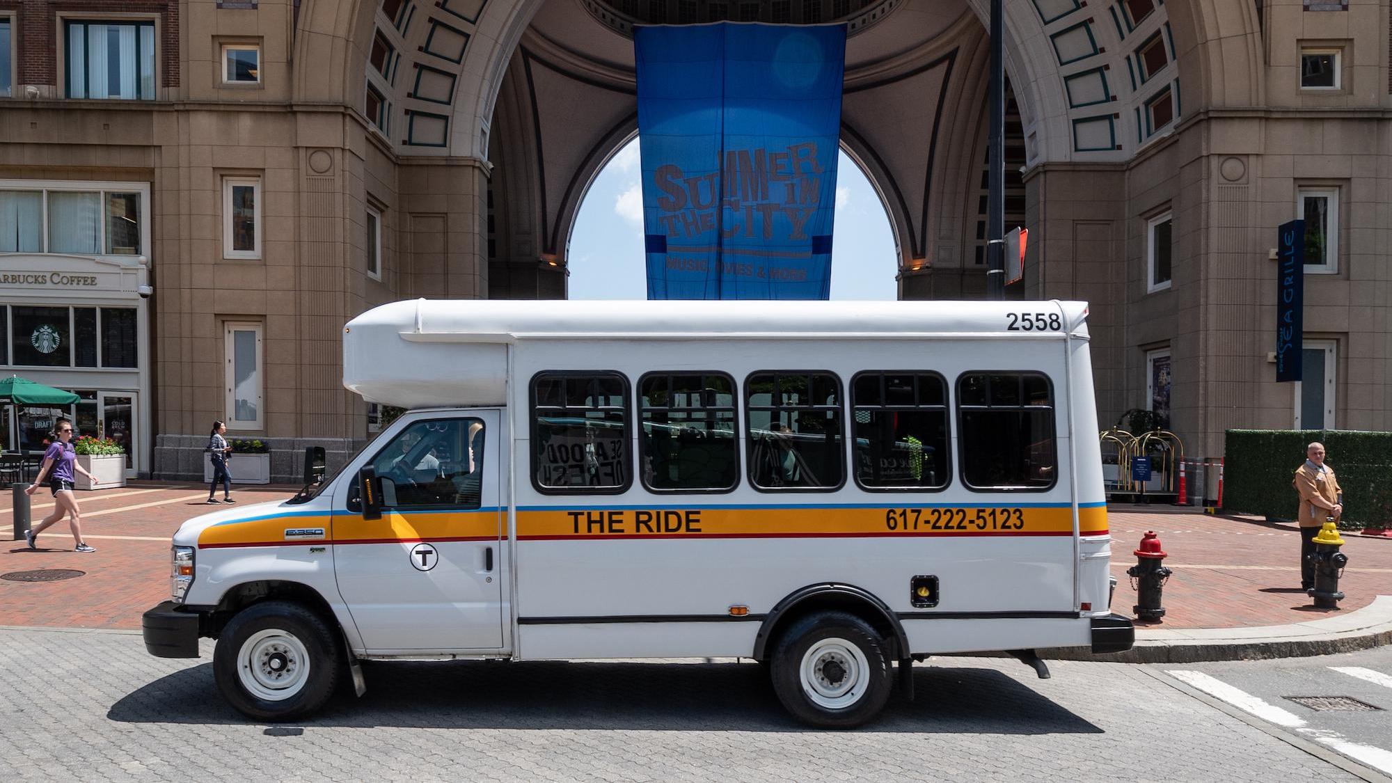
PRE-BID CONFERENCE for
RFP# 88-26
COMMBUYS Bid # BD-26-1206-MBTA-MBTA-130845
The MBTA’s Paratransit Dedicated Service Providers (“DSP”)
Tuesday, July 7, 2026, 11:00 a.m.
Notes:
Update the RFP # and RFP title
Enter the day, date and time of the Pre-Bid Conference

Slide 2

Introductions
Tracey Dionne
Strategic Sourcing Senior Manager
Procurement & Logistics
Chris Jurek
Interim Chief of Paratransit Services
Transportation Access / The RIDE
David Hatch
Deputy Director of Paratransit Optimization
Transportation Access/The RIDE
Jill Arnold
Deputy Director of Contract Management
Transportation Access/The RIDE
Notes:
Update the section highlighted in yellow with the name & title for all speaking during the pre-bid. Delete any text not being used.

Slide 3
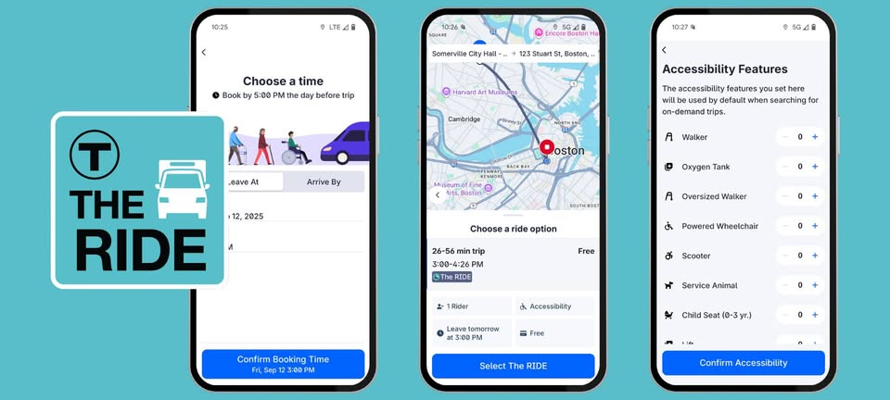
Pre-Bid Logistics
First and most important…
Thank you for being here and for your interest in partnering with the MBTA
This RFP will be managed via COMMBUYS. Instructions for log-in and use of COMMBUYS are described in Instructions for Vendors Responding to Bids.
For COMMBUYS assistance please contact the OSD Help Desk at 888-MA-State (627-8283) or osdhelpdesk@mass.gov.
This presentation in part or in whole is not meant to take precedence over the RFP documents in RFP 88-26 as posted on COMMBUYS, please refer to COMMBUYS for the most accurate information.
All communication regarding this bid must be submitted to the MBTA Procurement & Logistics point of contact via COMMBUYS.
Notes:
Make sure that the bidders know that they cannot not contact stakeholders or other MBTA staff regarding this bid; all communication must come thru Procurement & Logistics via COMMBUYS or email. Make mention of section 3.2.1 for the MBTA Designated Representative

Slide 4

Agenda
Overview of the Contract
Documents to be included in Your Response
Training & Additional Resources
General Q&A
Overview of the Diversity & Inclusion Requirements
Session Expectations
Request for Proposal (RFP) Structure
Important Dates
Notes:
Please follow this format – no adjustments should be needed.

Slide 5
Session Expectations
Today’s session is not a substitute for reading the Request for Proposal (RFP) document. The RFP includes important contract and response details that will not be covered during today’s meeting.
Although we will take general questions about the authority’s bidding process, at the end of today’s session, questions about the bid must be submitted through COMMBUYS using the Q&A feature before the Q&A deadline.
The COMMBUYS Q&A feature and important deadlines will be covered later in the presentation.
Notes:
No changes to this slide should be made.

Slide 6
RFP 88-26 The MBTA’s Paratransit Dedicated Service Providers (“DSP”)
Overview
RFP 88-26 The MBTA’s Paratransit Dedicated Service Providers
Contract Effective Date (estimated): January 1, 2027 (Mobilization begins)
Number of Awards: Multiple (Two to Four Providers)
Term: Seven-and-a-half-year (7.5) Base Agreement + Two (2) Two-Year Options
Service Start Date (estimated): July 1, 2027
Notes:
Update the RFP # & Title, products or services , Contract or Service Effective Date (choose contract or service), Term of the contract and number of awards (us only if more than one award will be made)

Slide 7
RFP Structure
​ ​ | Introduction​ | Scope of Work (Attachment A)​ | Bidders’ Instructions & Procurement Process​ | Submission of Response​ | Selection Process & Evaluation​ | Contract Terms & Conditions​ | Attachments​ | Response Forms​
Description​ | Introduces the RFP​ | Describes the​ Scope of Work ​ | Provides overview of procurement process and instructions​ | Directs the vendors on how and what documentation to submit with a proposal​ | Describes Responsiveness and Evaluation ​ | Contains the ​ contractual terms by which Bidder is ​ expected to abide​​ | Supporting Documentation ​ | Required Forms to be included with submission​
Key Information​ | - Duration of Contract (7.5-Year Base + Two 2-year Options) - RFP Background | - Scope of Work - Deliverables​​ | - Pre-Bid Conference ​ - RFP Calendar​ - Rules of Contact - Insurance | Submit on COMMBUYS: Technical Response & Price Response​ | - Pass/Fail - Technical Evaluation - Price Evaluation - Best-Value Award | Standard Terms and Conditions​​ | Forms, Exhibits, and RIDS | - Form B: Technical Response​ - Form D: Price Response​​
Notes:
Update the Duration of the Contract

Slide 8
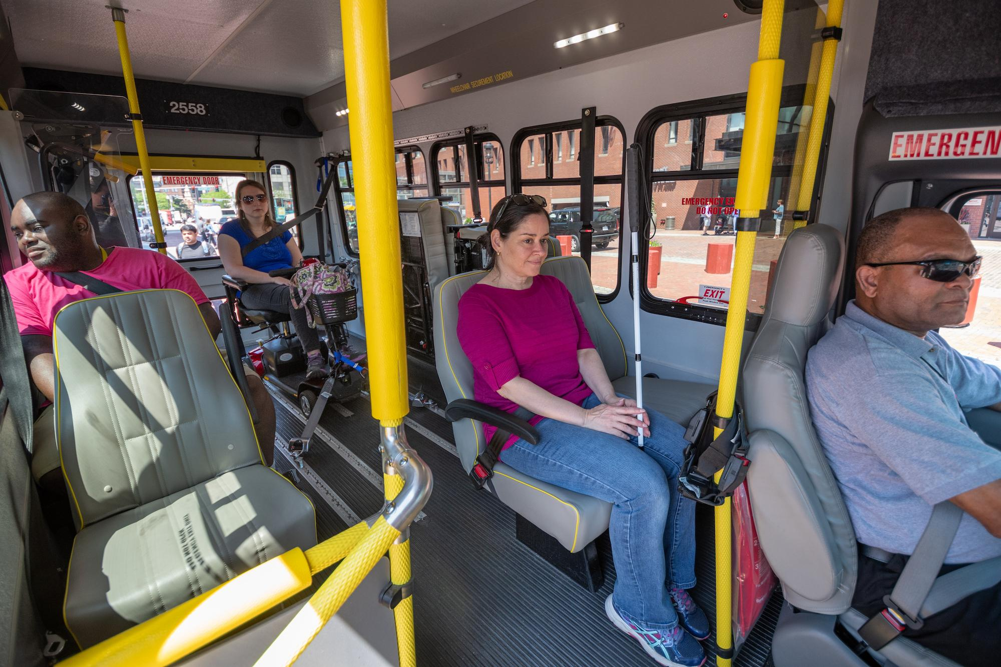
Contract Overview
The MBTA is seeking qualified Dedicated Service Providers (DSPs) to provide the service delivery and vehicle maintenance for its ADA Paratransit Services, The RIDE.
Goals for this Contract​
Increasing flexibility and efficiency of service hour provision​
Continuing current streak of overall system performance
Building on success of the new TMS adoption
Contract Structure
Service Level model for apportioning work
Facility location to be determined jointly in post-award negotiation process
Use of subcontractors – service delivery vs. other uses
Notes:
If additional slides are needed for different phases of the project, please add additional slides

Slide 9
Scope of Work Overview
The DSP’s main responsibilities are the following:
Provide Vehicle Operator (service) hours in required increments
Manage and oversee Vehicle Operator performance
  Real-time management of Vehicle Operators
  Road and safety supervision functions
  Collaborate in active service management with TRAC Dispatchers
Maintain all vehicles, including MBTA-owned revenue vehicles and DSP-provided non-revenue vehicles
Ensure all employees are properly trained and services delivered meet MBTA standards and requirements (QA/QC of own work)
Provide highly-skilled management team that can problem-solve and partner with the MBTA to drive continuous improvements
Notes:
If additional slides are needed for different phases of the project, please add additional slides

Slide 10
Key Scope of Work Changes
New in this RFP
Standardizing Vehicle Operator breaks​
Adopting updated plans & policies:​
  MBTA Paratransit Fleet Technology plan (RID H)​
  RIDE Service Planning and Run Cut Development policy (RID I)​
Dedicating vehicle maintenance operations (facility, staff, equipment, etc.) 100% to this contract (unless otherwise approved by MBTA)​
Potential Upcoming Operational Updates
Simplifying lost & found process​
Moving complaints handling​ to the new TMS
Ongoing efforts to move to MBTA-owned/controlled facilities​

Slide 11
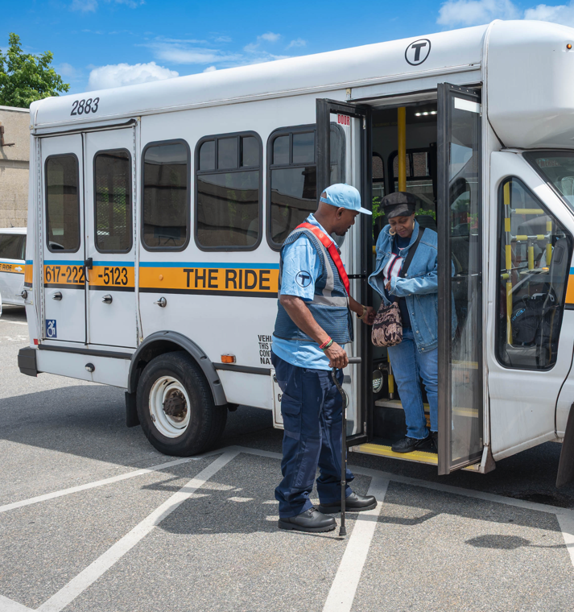
Performance Measures or Key Performance Indicators
Vendors' performance after contract award will be evaluated based on a number of criteria, including:
Service hour coverage
Number of complaints submitted
Responsiveness to incidents, accidents, and complaints
Maintenance and driver infractions
Supplier Diversity Requirements
Notes:
Input from the stakeholders is suggested for specific KPI’s or Performance Measurements for inclusion on this slide.

Slide 12
Bidder Evaluation Criteria
Bidder must complete all required forms and submit all other required forms listed in the RFP
The MBTA will evaluate each Response based on a combination of Pass/Fail Criteria, Technical Evaluation Criteria, and Price Responses to determine the Best Value for the Authority.
All Responses will be reviewed for:
The responsiveness of the Bidder to the requirements set forth in the RFP.
Conformance to the RFP instructions regarding organization and format.
Deficiencies and minor informalities, apparent clerical mistakes which are unrelated to the substantive content of the Response for clarification.
Pass/Fail
Price
Technical
Supplier Diversity

Slide 13
Bidder Evaluation Criteria
Technical Response
The MBTA will evaluate the following weighted criteria to determine a single Technical Score for each Bid:
Technical Evaluation Criteria | Technical Score Weighting | Corresponding Scope of Work Sections
Bidder Experience and Past Performance | 15% | -
Management and Administration | 30% | 2. Management and Staffing 3. Training 8. Quality Assurance 9. Reporting 11. Mobilization and Transition
Service Delivery | 20% | 4. Vehicle Operations and Supervision 5. Fleet and Maintenance 6. Service Planning
Safety | 10% | 7. Safety
Supplier Diversity | 25% | -

Slide 14
Bidder Evaluation Criteria
Price Response
For each responsive Service Level proposal, for each year of Contract, the Weighted Average Total Cost per Hour will be calculated within Form D – Price Response for comparison.
Weighted Average of Total Cost per Hour
  = Service Level Minimum Total Cost per Hour x 15%
  + Service Level Target Award Point Total Cost per Hour x 70%
  + Service Level Maximum Total Cost per Hour x 15%

Slide 15
Basis of Award
Best-Value Scenarios
The MBTA will evaluate all possible Scenarios of Bidder Service Level proposals to determine the Best-Value Award using the following:
  Scenario Technical Capability: Sum of Bidder Technical Scores x Service Level Percentages
  Scenario Cost to Provide Service: Sum of Bidder Weighted Averages of the Total Cost per Hour x Service Level Percentages
  System Resiliency and Redundancy: Number of Eligible Bidders and Distribution of Service Hours across Bidders
Each Bidder in the selected Scenario will be awarded the specific Service Level proposed and approved as part of the Scenario.
Notes:
Remove the last bullet if the solicitation is less than $250K. Later in the presentation we will provide resources and information for the Supplier Diversity Program.

Slide 16
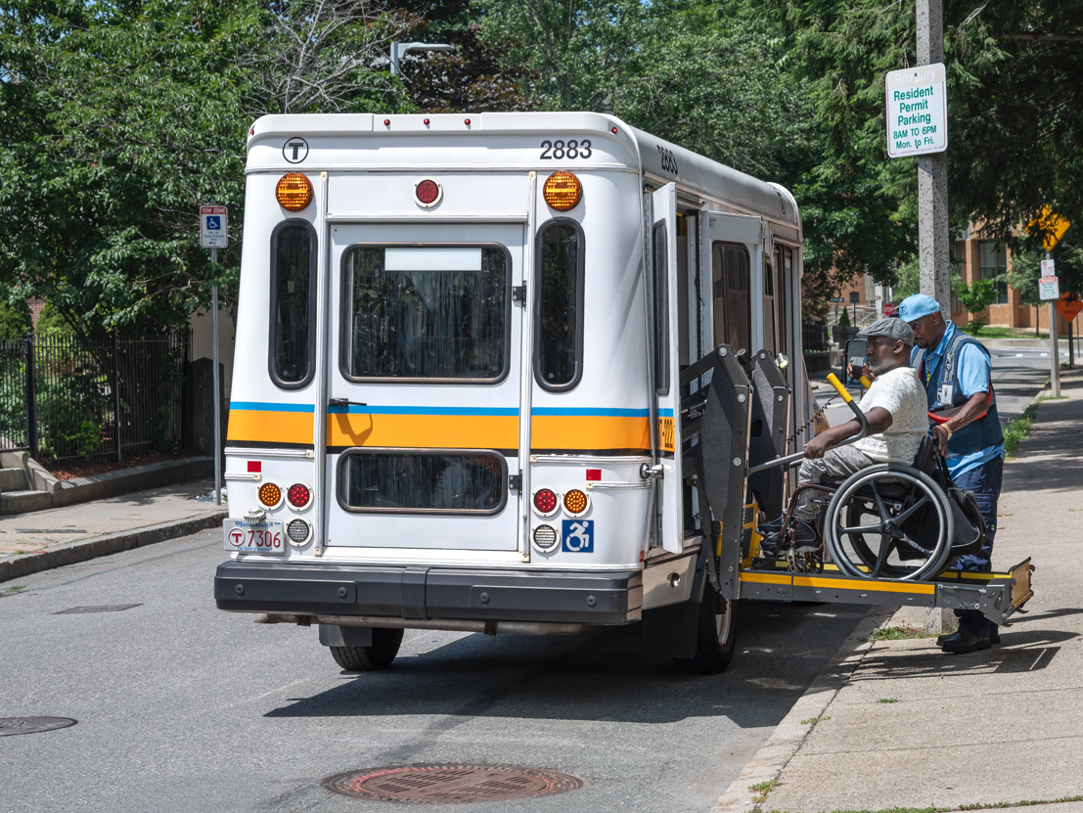
Basis of Award
Best-Value Award
Bidders are advised that the MBTA is not bound to accept the lowest priced Response or the Response with the highest Technical Response Score.
The selection will be made on a best-value basis, evaluating price along with other factors.
Each criterion will be evaluated considering all the information included in the Bidder Response related to the criterion, as well as other information gathered from references, presentation, and on-site visits if requested.
Responses will also be evaluated based on the Supplier Diversity Criteria which will account for 25% of the overall technical scoring.
Notes:
Remove the last bullet if the solicitation is less than $250K. Later in the presentation we will provide resources and information for the Supplier Diversity Program.

Slide 17
Submission of Responses
RFP 88-26 The MBTA’s Paratransit Dedicated Service Providers (DSPs)
RFP Response, including:
Bid Cover Letter
Power of Attorney (as described in Section 4.2 of the RFP)
Form A: Pre-Award Bidder Evaluation Data Form
Form B: Technical Response (as described in the Form B submission requirements)
Form C: Small Business Attestation Form
Other items as applicable
Price Response as a separate document, including:
Form D: Price Response (as described in the Form D submission requirements)
Exhibit 2: Bidder Service Level Staffing
Exhibit 1: Bidder Experience and References

Slide 18
Submission of Responses
Considerations of Bidding Across Multiple Service Levels
Bids including multiple service levels must:
Indicate all proposed Service Levels in the Bid Cover Letter
Provide additional Form B: Technical Response details specific to individual service levels
Provide all relevant staffing in Exhibit 2: Bidder Service Level Staffing
Include all relevant pricing information in Form D: Price Response

Slide 19
Technical Response Submission
Accessibility Considerations
Bids must conform to the accessibility requirements set forth in the instructions to Form B and ensure that responses comply with, at minimum:
The Commonwealth of Massachusetts Enterprise Digital Accessibility Policy
Title II and/or Title III of the Americans with Disabilities Act (ADA), as applicable;
Section 504 of the Rehabilitation Act of 1973;
Section 508 of the Rehabilitation Act, where applicable; and
Web Content Accessibility Guidelines (WCAG) 2.1 Level AA, or any subsequently adopted equivalent standard.
The Technical Response must be submitted in both
PDF and Word Document (or compatible) formats.

Slide 20
Price Response Submission
Form D: Bidder Cost Model – Critical Tabs
Instructions: Detailed instructions for how to fill out the spreadsheet.
INPUTS: Provide cost data for the first full year of service delivery (Contract Year 1: July 1, 2027 to June 30, 2028). Data from this tab will auto-populate into the Proposal Summary and Contract Years 1-11.
Mobilization & Transition: Provide cost data for the Mobilization & Transition period of the Base Contract (Contract Execution to Service Start, estimated January 1, 2027 to June 30, 2027). Data from this tab will auto-populate into the Proposal Summary.
Assumptions: Provide the breakdown of all Fringe components for each year of the Contract, beginning with the first full year of service delivery. Data from this tab will auto-populate into the INPUTS that flow into the Proposal Summary and Contract Years 1-11.

Slide 21
Price Response Submission
Form D: Bidder Cost Model – Additional Tabs
Proposal Summary: Reference tab for the Selection Committee to the total Price Responses across Contract Years by Service Level. Includes calculations for the Weighted Average of Total Cost per Hour.
Service Hour Projections: Reference tab for Bidders to understand the range of service hours by Service Level for each Contract Year.
Contract Years 1-11: Reference tabs for Bidders to review the annual calculations based on INPUTS and for Selection Committee to see annual cost elements.
Award Summary: Reference tab to calculate the total Not-To-Exceed Contract Award Values for Awarded Bidders only.
The Price Response must be submitted as a separate document from the Technical Response. No pricing information may be included in any part of the Technical Response.

Slide 22

What Makes a Compliant Proposal Response?
Be sure to read the RFP.
Pay attention to the mandatory requirements.
Note maximum page limits (see Form B).
Ensure all required documents are submitted.
Complete the bidders’ response forms in their entirety.
Notes:
Remove or update this statement based on the requirements in the RFP.

Slide 23
Important Dates
Procurement Activity | Date | Time
RFP issued | June 24, 2026
Pre-bid conference | July 7, 2026 | 11:00 a.m.
Deadline for submission of Confidentiality and Non-Disclosure Agreement | July 14, 2026 | 5:00 p.m.
Deadline for submission of Bidder Questions via COMMBUYS Q&A | July 29, 2026 | 2:00 p.m.
Final Answers to Bidder Questions published by MBTA on COMMBUYS | August 4, 2026 | E.O.D.
Response Due Date | August 19, 2026 | 2:00 p.m.
In-person or virtual presentations at MBTA (estimated) | September 28 – October 2, 2026
Contract Execution (estimated) | December 2026
Facility Planning Process (estimated) | December 2026 – February 2027
Mobilization & Transition Period (estimated) | January 2027 – June 2027
Service Start Date (estimated) | July 1, 2027

Slide 24
Overview of Supplier Diversity & Inclusion
Notes:
In this section we will provide an overview of the Supplier Diversity & Inclusion requirements which are 25% of the points in the evaluation process. This requirement strengthens and increases business opportunities for partnership with companies certified by the Supplier Diversity Office. There are many resources in this section that will guide all bidders to further understand the program, its importance and the resources for help from the SDO office if needed.

Slide 25
Supplier Diversity & Inclusion Program
The Commonwealth's Supplier Diversity Program (SDP) promotes business-to-business relationships between awarded Contractors and diverse businesses and non-profit organizations (SDP Partners) certified or recognized by the Supplier Diversity Office (SDO). The MBTA seeks Proposals that incorporate participation by SDP Partners in as many aspects of the services as possible.
Section 5 MBTA Policies in the RFP provides bidders with detailed information and resources relating to:
  Program background
  Financial Commitment Requirements
  Eligible SDP Partner Certification Categories
  Eligible Types of Business-to-Business Relationships
  Program Flexibility
  SDP Spending Reports and Compliance

Slide 26
Key Supplier Diversity Contract Requirements
  Bidders must propose a specific commitment to be spent with certified diverse companies (SDP Partners).
  Contractors must report spending with SDP Partner(s) for the duration of the contract. All awarded prime vendors that commit to partnerships with diverse partnerships with diverse subcontractors will be responsible for using B2Gnow, an online contract compliance system.
  SDP Partners utilized by Contractors must be listed in one of the two directories identified in this presentation.
The SDP requirements apply even if your company:
  Does not have SDP Partners at the moment.
  Is a certified diverse business.
!

Slide 27
Recognized Third-Party Certifying Organizations
Certifying Organizations | Certification Category
Greater New England Minority Supplier Development Council (GNEMSDC) | MBE
Center for Women & Enterprise (CWE) (New England – WBENC) | WBE
City of Boston | MBE/WBE
VetBiz/U.S. Department of Veterans Affairs | VOSB/SDVOSB
NGLCC – National LGBT Chamber of Commerce | LGBTBE
Disability: IN (formerly the US Business Leadership Network – USBLN) | DOBE and SDVOBE

Slide 28
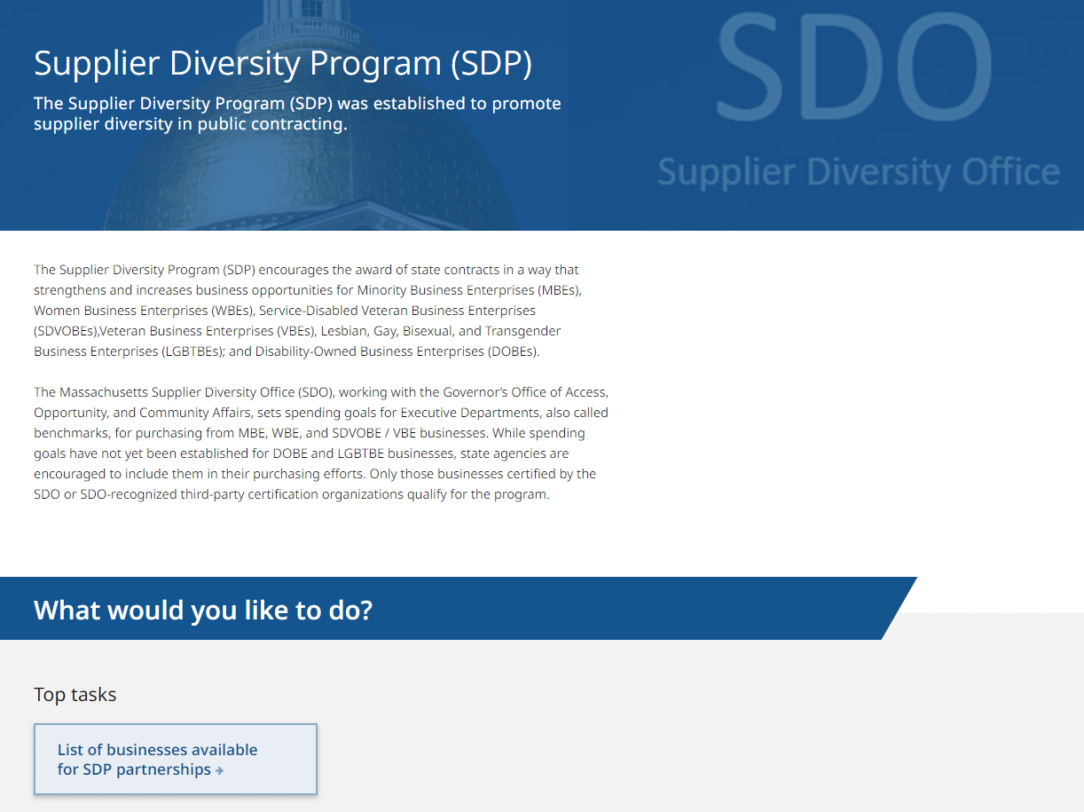
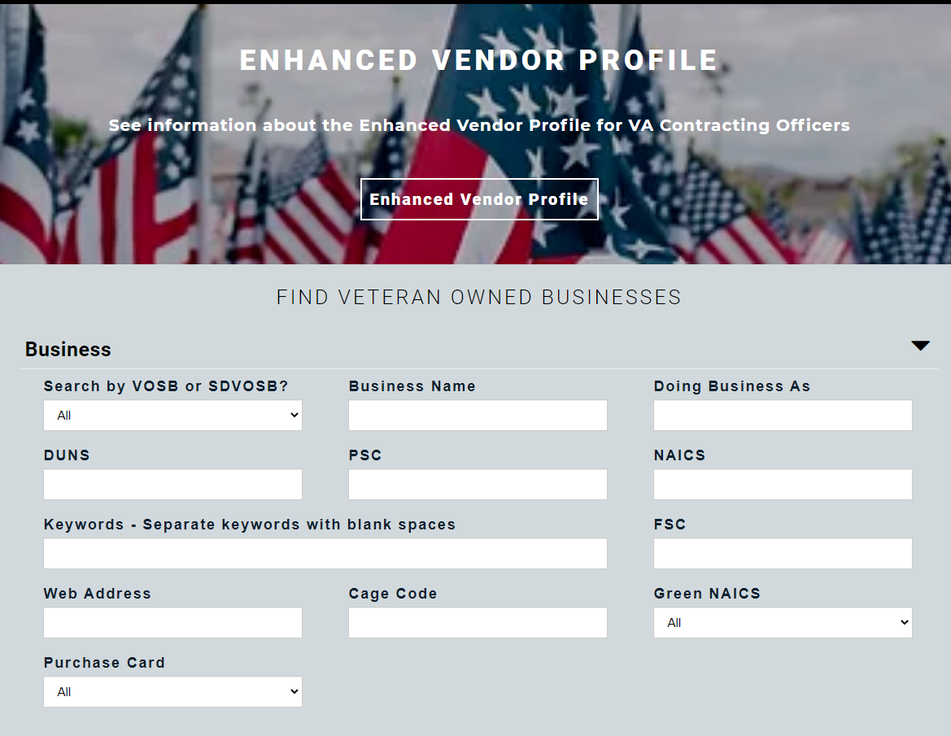
Finding Partners
Online Directories of Certified Businesses
The SDO Directory of Certified Businesses
More than 3,700 certified businesses
MBE, WBE, VBE, SDVOBE, DOBE, LGBTBE
www.mass.gov/sdp
The U.S. Veterans Administration
Vendor Information Pages (VIP)
More than 14,000 certified businesses
VOSB, SDVOSB
https://vetbiz.va.gov/basic-search/

Slide 29

Finding Eligible Certified Partners
1
Find current suppliers that are certified
Download the lists of eligible SDP partners from the SDO and VetBiz directories and compare your current suppliers to those lists.
2
Find current suppliers that may be certified
Survey your suppliers to find diverse companies that are not certified or are certified by an organization other than the Massachusetts SDO. Connect them with the SDO (sdp@mass.gov) and encourage them to get certified.
3
Identify subcontracting needs that may be met
by a new diverse business partner
On an ongoing basis, closely monitor incoming state orders and projects for the potential to hire diverse businesses as subcontractors.
Online Certification Self-Assessment Tool:
https://www.mass.gov/forms/take-the-certification-self-assessment
4
Identify general business needs that may be met
by a new diverse business partner
On an ongoing basis, review your company’s business needs, including one-time purchases, to find areas where you may include new diverse suppliers.

Slide 30
Training Resources

Slide 31
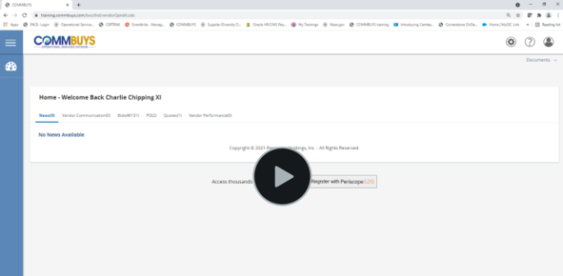
COMMBUYS Q&A
COMMBUYS Q&A is a tool to manage dialogue between buyers and bidders.
Please watch this short video that demonstrates how to use the tool to ask questions about the bid.
Link to the video
Notes:
To all Bidders: Please watch this short video that demonstrates how to use the tool to ask questions about the bid.

Slide 32
COMMBUYS Training
View
Participate
Pre-recorded Webcast
How to Locate and Respond to Bid Solicitations in COMMBUYS
Link to the recording.
Link to the Vendor Training Schedule;
Read
Job Aids
How to Create a Quote in COMMBUYS
Using the Q&A Tab within a COMMBUYS Bid
How to Withdraw, Reopen, and Resubmit a Quote
Basic COMMBUYS Navigation and Searching for the Seller Role
Notes:
On this slide we have a variety of methods to review the training material, you can View the webcast Participate in Vendor Training or Read the job aids

Slide 33
Important steps to follow for bid submission
Acknowledge the Bid
Bidders are encouraged to Acknowledge the bid to be notified of any updates/amendments to the bid, including changes to the bid opening date/due date.
To receive these updates:
Login to COMMBUYS
Navigate to the bid using the Advanced Search
Select "Yes" on the Acknowledge Receipt and View Solicitation window.
You must be registered in COMMBUYS to take this action.
Questions?
OSD Help Desk
Monday – Friday, 8:00 a.m. – 5:00 p.m.
888-MA-State (627-8283)
OSDHelpDesk@mass.gov
Plan to Submit Your Response
All responses must be submitted in COMMBUYS by the Bid Opening Date and Time; late responses may not be accepted.
It is imperative that bidders allow sufficient time to submit their quote, and bidders are advised – at a minimum – to begin well in advance of the Bid Opening Date and at a time when OSD Help Desk staff are available for questions.
Notes:
Move this to the end

Slide 34
Questions?

Slide 35
Closing
This presentation in part or in whole is not meant to take precedence over the RFP documents in RFP 88-26 as posted on COMMBUYS, please refer to COMMBUYS for the most accurate information.
RFP Schedule and any dates mentioned are subject to change at the discretion of the MBTA. Please refer to COMMBUYS for the most accurate information.
Confidentiality and Non-Disclosure Agreement (Deadline – 7/14/26 at 5:00 p.m.) (Submit to tdionne@mbta.com).
Questions should be posted on COMMBUYS (Deadline – 7/29/26 at 2:00 p.m.)
Any and all communication during the non-mandatory Bidders’ Conference of 7/7/26 represents no favor to attendees. All Bidders’ responses will be treated equally regardless of attendance.
This Presentation will be posted on COMMBUYS in the File Attachments section.
Thank You for your interest in partnering with the MBTA.
Notes:
Update the highlighted dates, time and RFP #

Slide 36
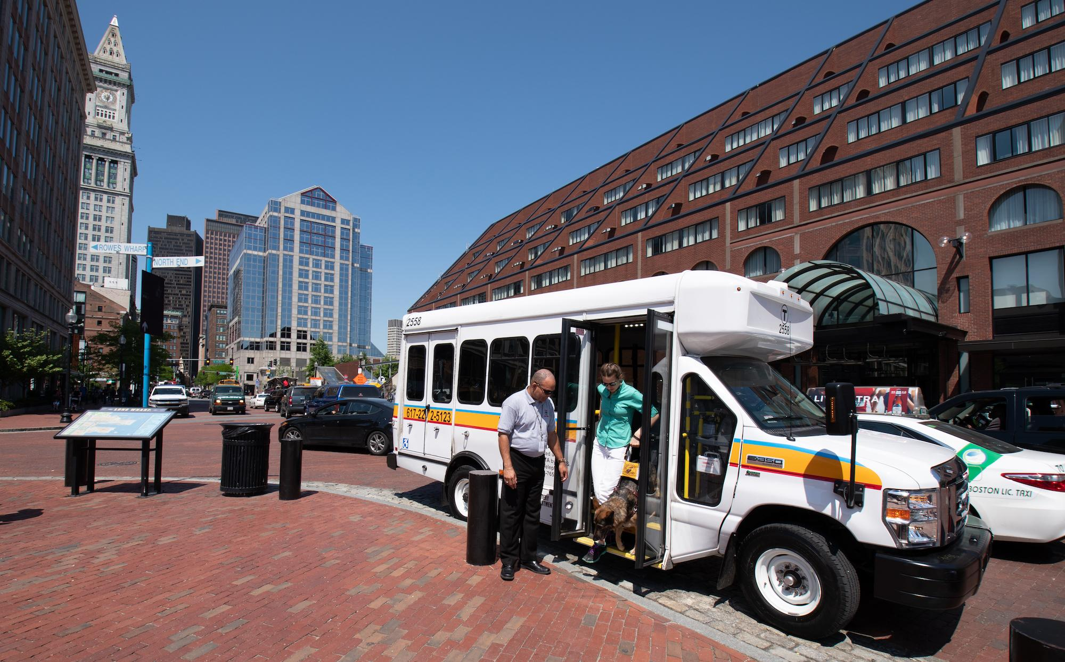
Thank you for attending!
Notes:
Question slide

