Slide 1

We Will begin Shortly.
Please enter the below information in the chat:
Name
Company
Contact Information- Email and Phone Number
Are you a prime or a subcontractor?
Are you a certified BEP-Veteran Vendor?

Slide 2
WELCOME
Pre-bid Conference – jpmc Telecom Voices Services - Modern Services
Bid Buy # 26-448DOIT-TELEC-B-49386

Slide 3

AGENDA
Welcome
  Patrick Kelleher
Questions
Only Questions written in chat will be responded to for record keeping purposes.
IFB Highlights and Questions
  ITPO Lead - Patrick Kelleher
  Subject Matter Expert – Levi Clemens
  Darin Herman

Slide 4
IFB Goal & Ideal Outcomes
GOAL:
  This solicitation is issued by the State of Illinois, through the Department of Innovation and Technology, in cooperation and agreement with the Chief Procurement Officer for General Services, to fulfill the State’s private telecommunications voice service needs.
  Foster an inclusive, equitable and competitive business environment that supports underrepresented businesses in Illinois.
  Establish one (1) JPMC contract to enable All Governmental Agencies and Qualified Not-for-Profit Entities to purchase Direct Inward Dialing (DID) for routing external calls directly to internal users, long-distance calling, toll-free inbound services, and dedicated voice circuits on an as needed basis during the contract period. Solutions also include standard business voice lines, enhanced calling features, directory assistance, operator services, and support for SIP-based voice connectivity.
OUTCOMES:
  Transition from legacy copper-based telephony (e.g., POTS, Centrex) to modern, IP-based solutions such as VoIP and cloud-based voice services to improve service quality, scalability, and cost efficiency.
  Establish clear service-level agreements (SLAs) that define performance expectations for availability, uptime, incident response, provisioning times, and customer support.

Slide 5
BidBuy Attachments
Attachment A: Service Level Agreement (SLA) – Technical Desirable F.3.22 – Vendor Signature
Attachment B: Cloud Security
  Vendor will notify the State Chief Information Security Officer (CISO) within 24 hours of first becoming aware of any actual or reasonably suspected information breach or other security incident which impacts State data. Email notification must be sent to: DoIT.Security@illinois.gov with the subject line 'Breach Notification’.
Attachment C: Assigned Services per Illinois Counties
Attachment D: Master Pricing Tool Excel Spreadsheet by County
Attachment E: Information and Technology Terms and Conditions
  Illinois Prompt Payment Act and rules. 30 ILCS 540; 74 III. Adm. Code 900.
  Invoicing: By submitting an invoice, Vendor certifies that the supplies or services provided meet all requirements of this Contract, and the amount billed and expenses incurred are as allowed in this Contract.
  All Notices: DoIT.GeneralCounsel@illinois.gov and DoIT.ITPO.Communications@illinois.gov

Slide 6

Financial Disclosures (Required Submission)
Financial Disclosures – Vendor Disclosures (Formerly Forms A) or IPG Active Registered Vendor Disclosures (Formerly Forms B)
Active Registered Vendor Disclosures are for vendors registered in the Illinois Procurement Gateway
Vendor Disclosures are for vendors NOT registered in the Illinois Procurement Gateway
________________________________________________________
If the Bidder includes any subcontractors with an annual value over $100,000, then Bidder shall complete Section 1.6 Subcontracting of the IFB document
  Must include subcontractor Vendor Disclosures or IPG Active Registered Vendor Disclosures
  Subcontractors are required to be certified with both
  Illinois Secretary of State/ Illinois Board of Elections if
  annual value is over $50,000.
Responsiveness

Slide 7
Illinois Department of Human Rights Public Contracts Number
https://dhr.illinois.gov/public-contracts/where-to-start.html
Illinois Secretary of State – In Good Standing
https://www.ilsos.gov/departments/business_services/incorporation/
home.html
Board of Elections- must be registered at the time you have submitted your proposal
https://www.elections.il.gov/BEREP.aspx?MID=5kJmo5Vlmig%3d
Technical Proposal (Required Submission)
    Mandatory Requirements without Evidence – 39
    Mandatory Requirements with Evidence – 3
    Technical Desirables – 24
Points: Technical Requirements (1,000) +Commitment to Diversity (200) + Pricing (500) = Total 1,700 Points
Signed Offer (Required Submission)
Responsiveness

Slide 8
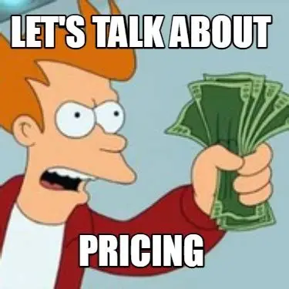

Required documents
(continued)
C2D Vendor Answer Sheet v.24.4~4.docx
Attachment D Master Pricing Tool Excel Spreadsheet by County v.3.10.26~1.xlsx
Entering cost, pricing or discount information in the Alternate Description may result in disqualification.
https://cpo-general.illinois.gov/commitment-to-diversity.html
Check the “Does this Attachment contain any pricing, cost or discount information?” box. Failure to mark box when attaching the pricing document may result in disqualification.”

Slide 9
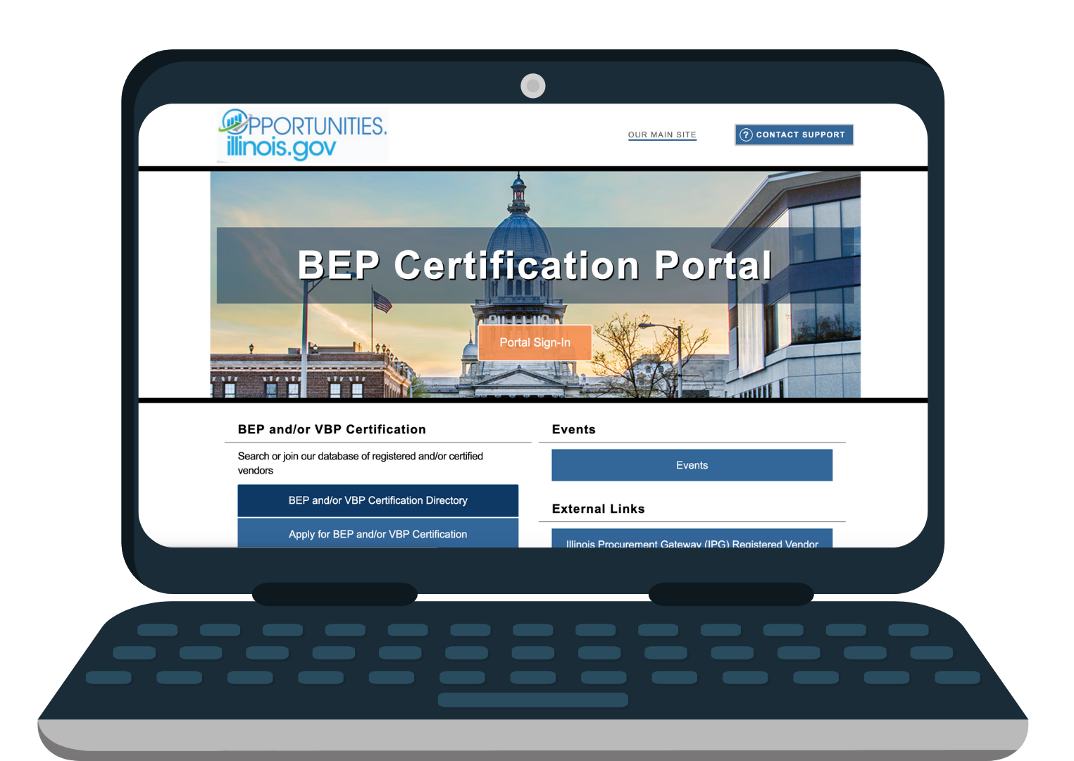
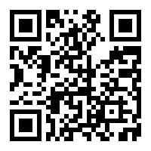
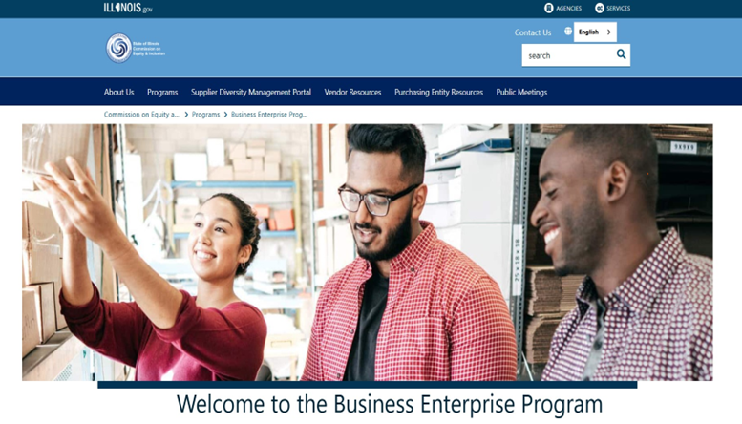
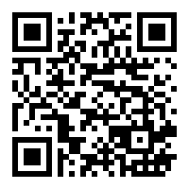
Diversity Contract Monitoring System (DCMS)
&
Compliance Resources
CEI BEP Diversity Management System
BidBuy
Bid Buy

Slide 10


Slide 11

Important Dates
Proposals are to be submitted in Bid Buy by 04/30/2026 1:00:00 PM (CST).
Do not submit via email.
Register in Bid Buy
For Vendor assistance contact the Bid Buy Vendor Help Desk by email at il.bidbuy@illinois.gov or by phone at 866-455-2897
Hours of Operation: Monday through Friday from 8:30am to 4:30pm CT.

Slide 12

Thank you.
All questions must be submitted in writing to patrick.kelleher@Illinois.gov no later than close of business 10 days before proposal due date. Answers to questions will be posted as an Amendment in Bid Buy. No responses will be provided in email.

Slide 13


Questions?
Thank You for your time.

